Slide 1

Room Occupancy Estimation
Group 9

Slide 2
Data Set Information
Data set for estimating the precise number of occupants in a room using multiple non-intrusive environmental sensors like temperature, light, sound, CO2 and PIR.
Attributes - Date: YYYY/MM/DD, Time: HH:MM:SS, Temperature: In degree Celsius, Light: In Lux, Sound: In, CO2: In Parts-per-million (PPM), CO2 Slope: Slope of CO2 values taken in a sliding window, PIR: Binary value conveying motion detection, Room_Occupancy_Count: Ground Truth
The data set was obtained from UCI Machine Learning Repository.

Slide 3
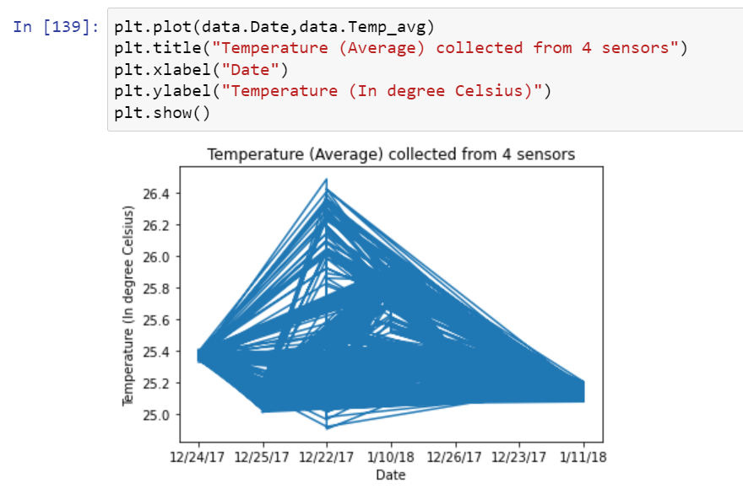
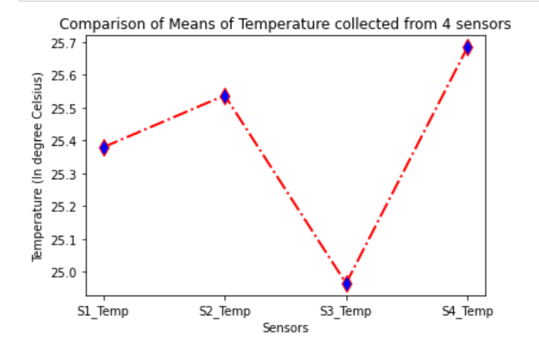
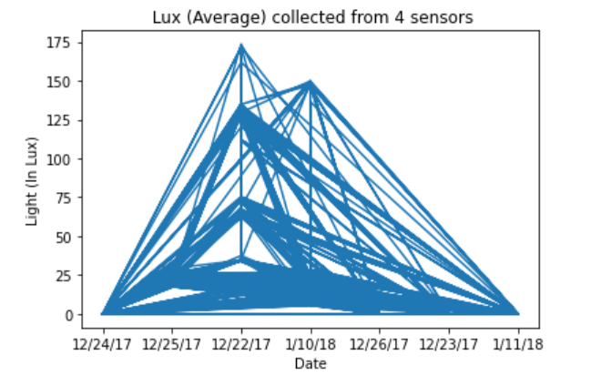
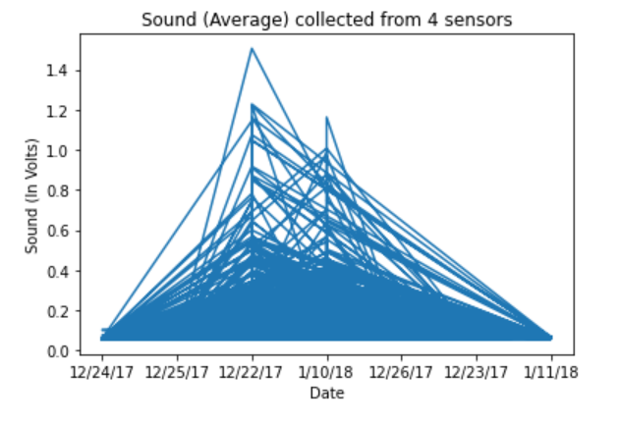
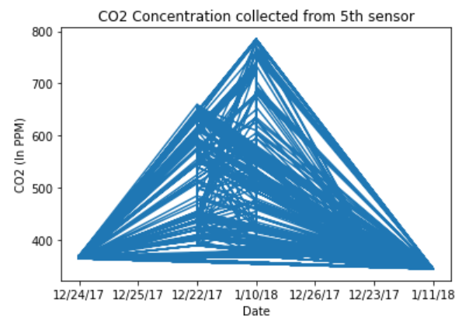
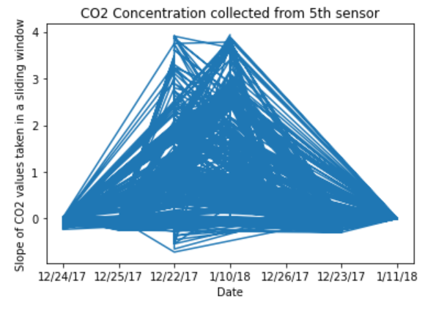
Visualizing Features using Line Plot

Slide 4
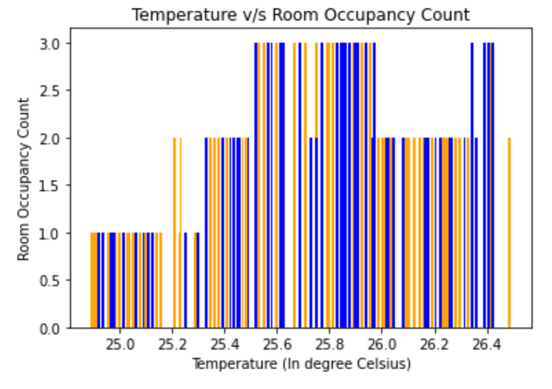
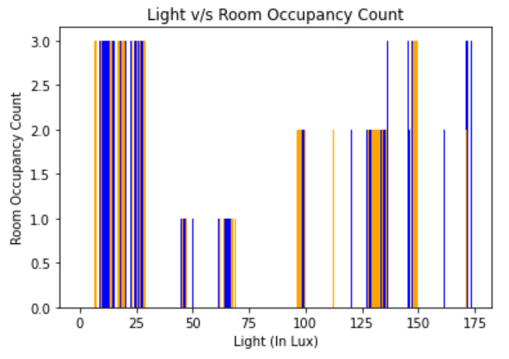
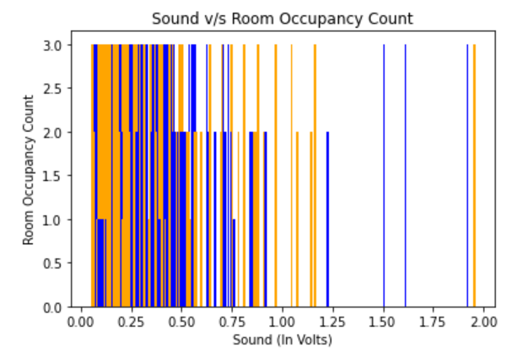
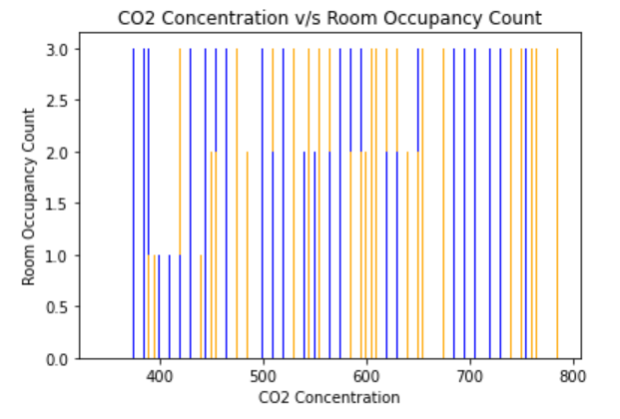
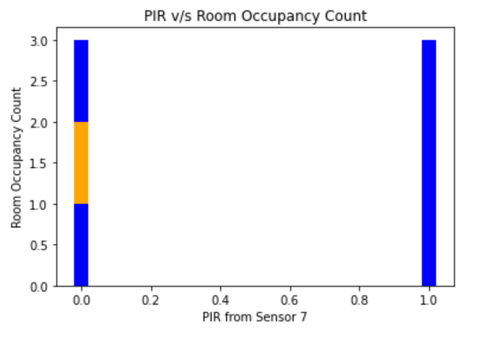
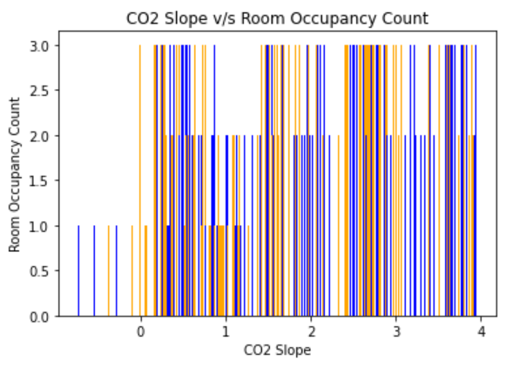
Visualizing Features using Bar Charts

Slide 5
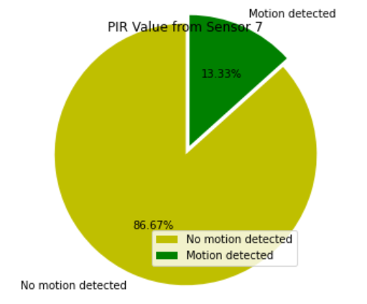
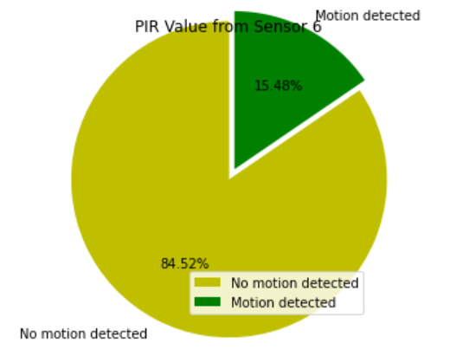
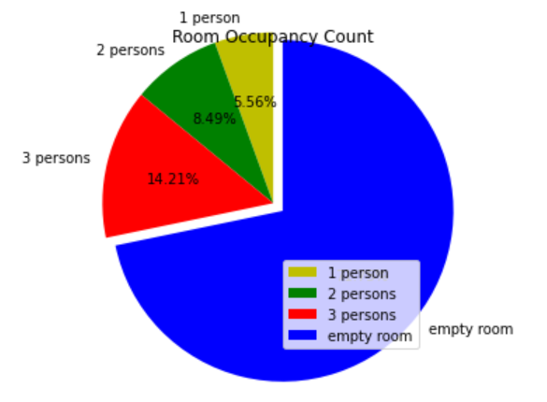
Visualizing Features using Pie Charts

Slide 6
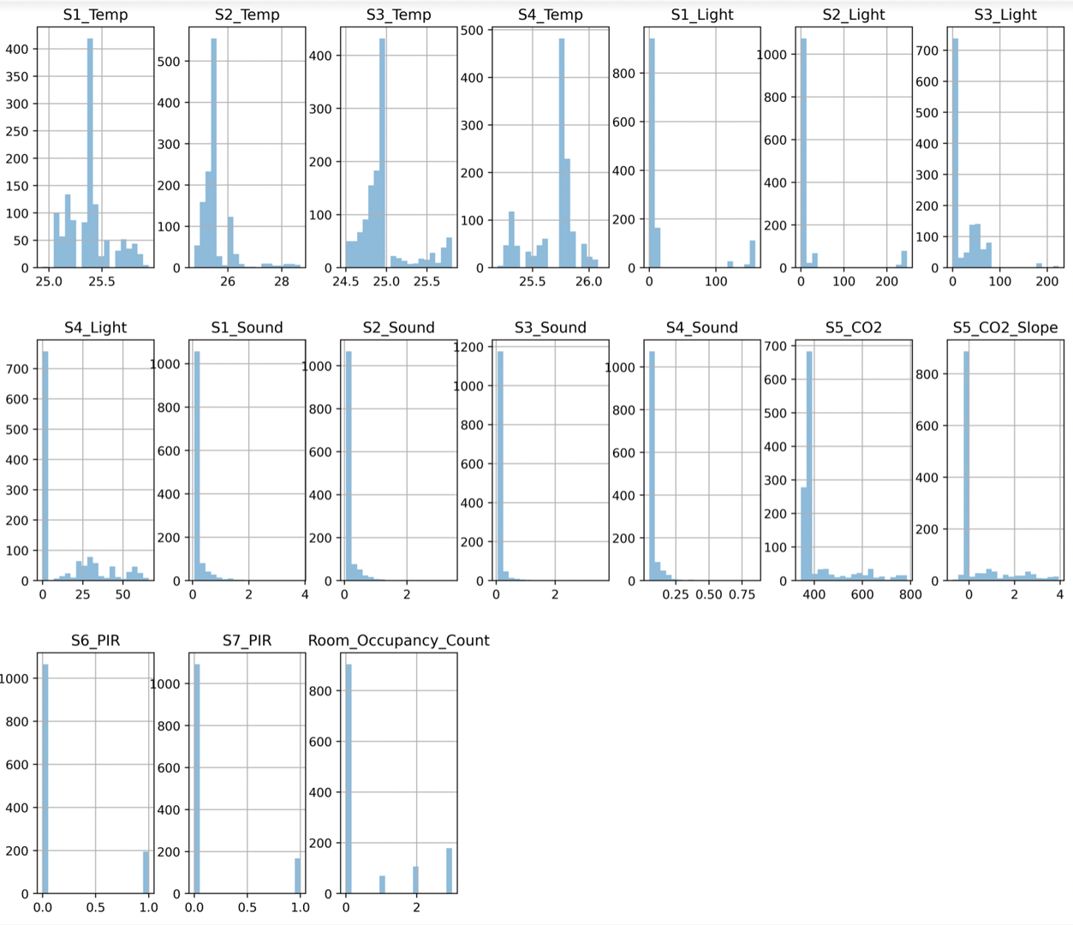
Visualizing Features using Histogram

Slide 7
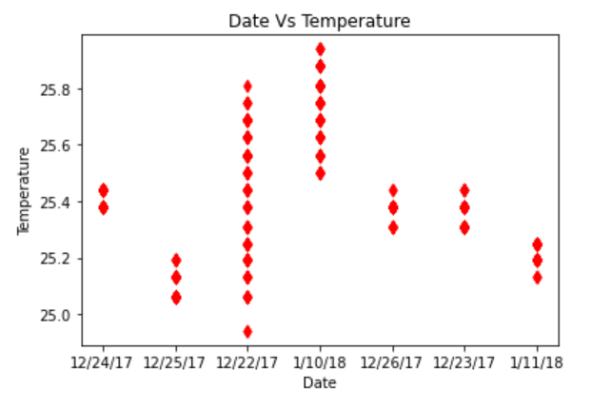
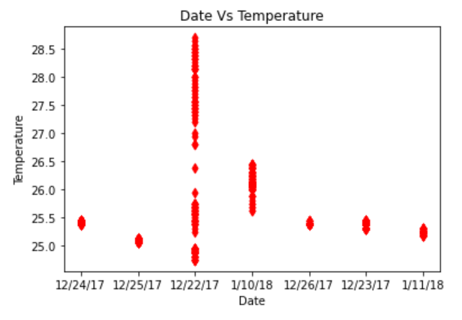
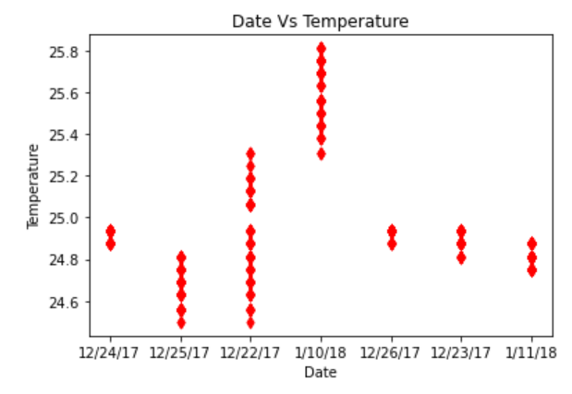
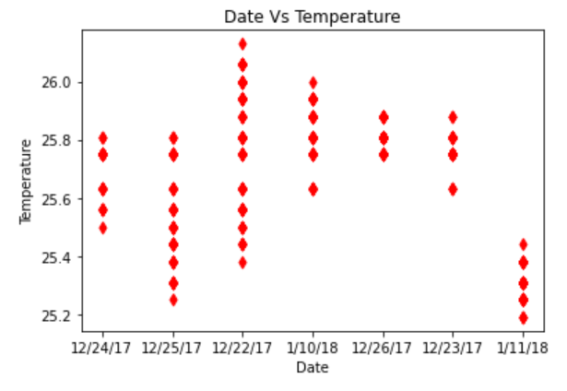
Visualizing Feature using Scatter Plots

Slide 8
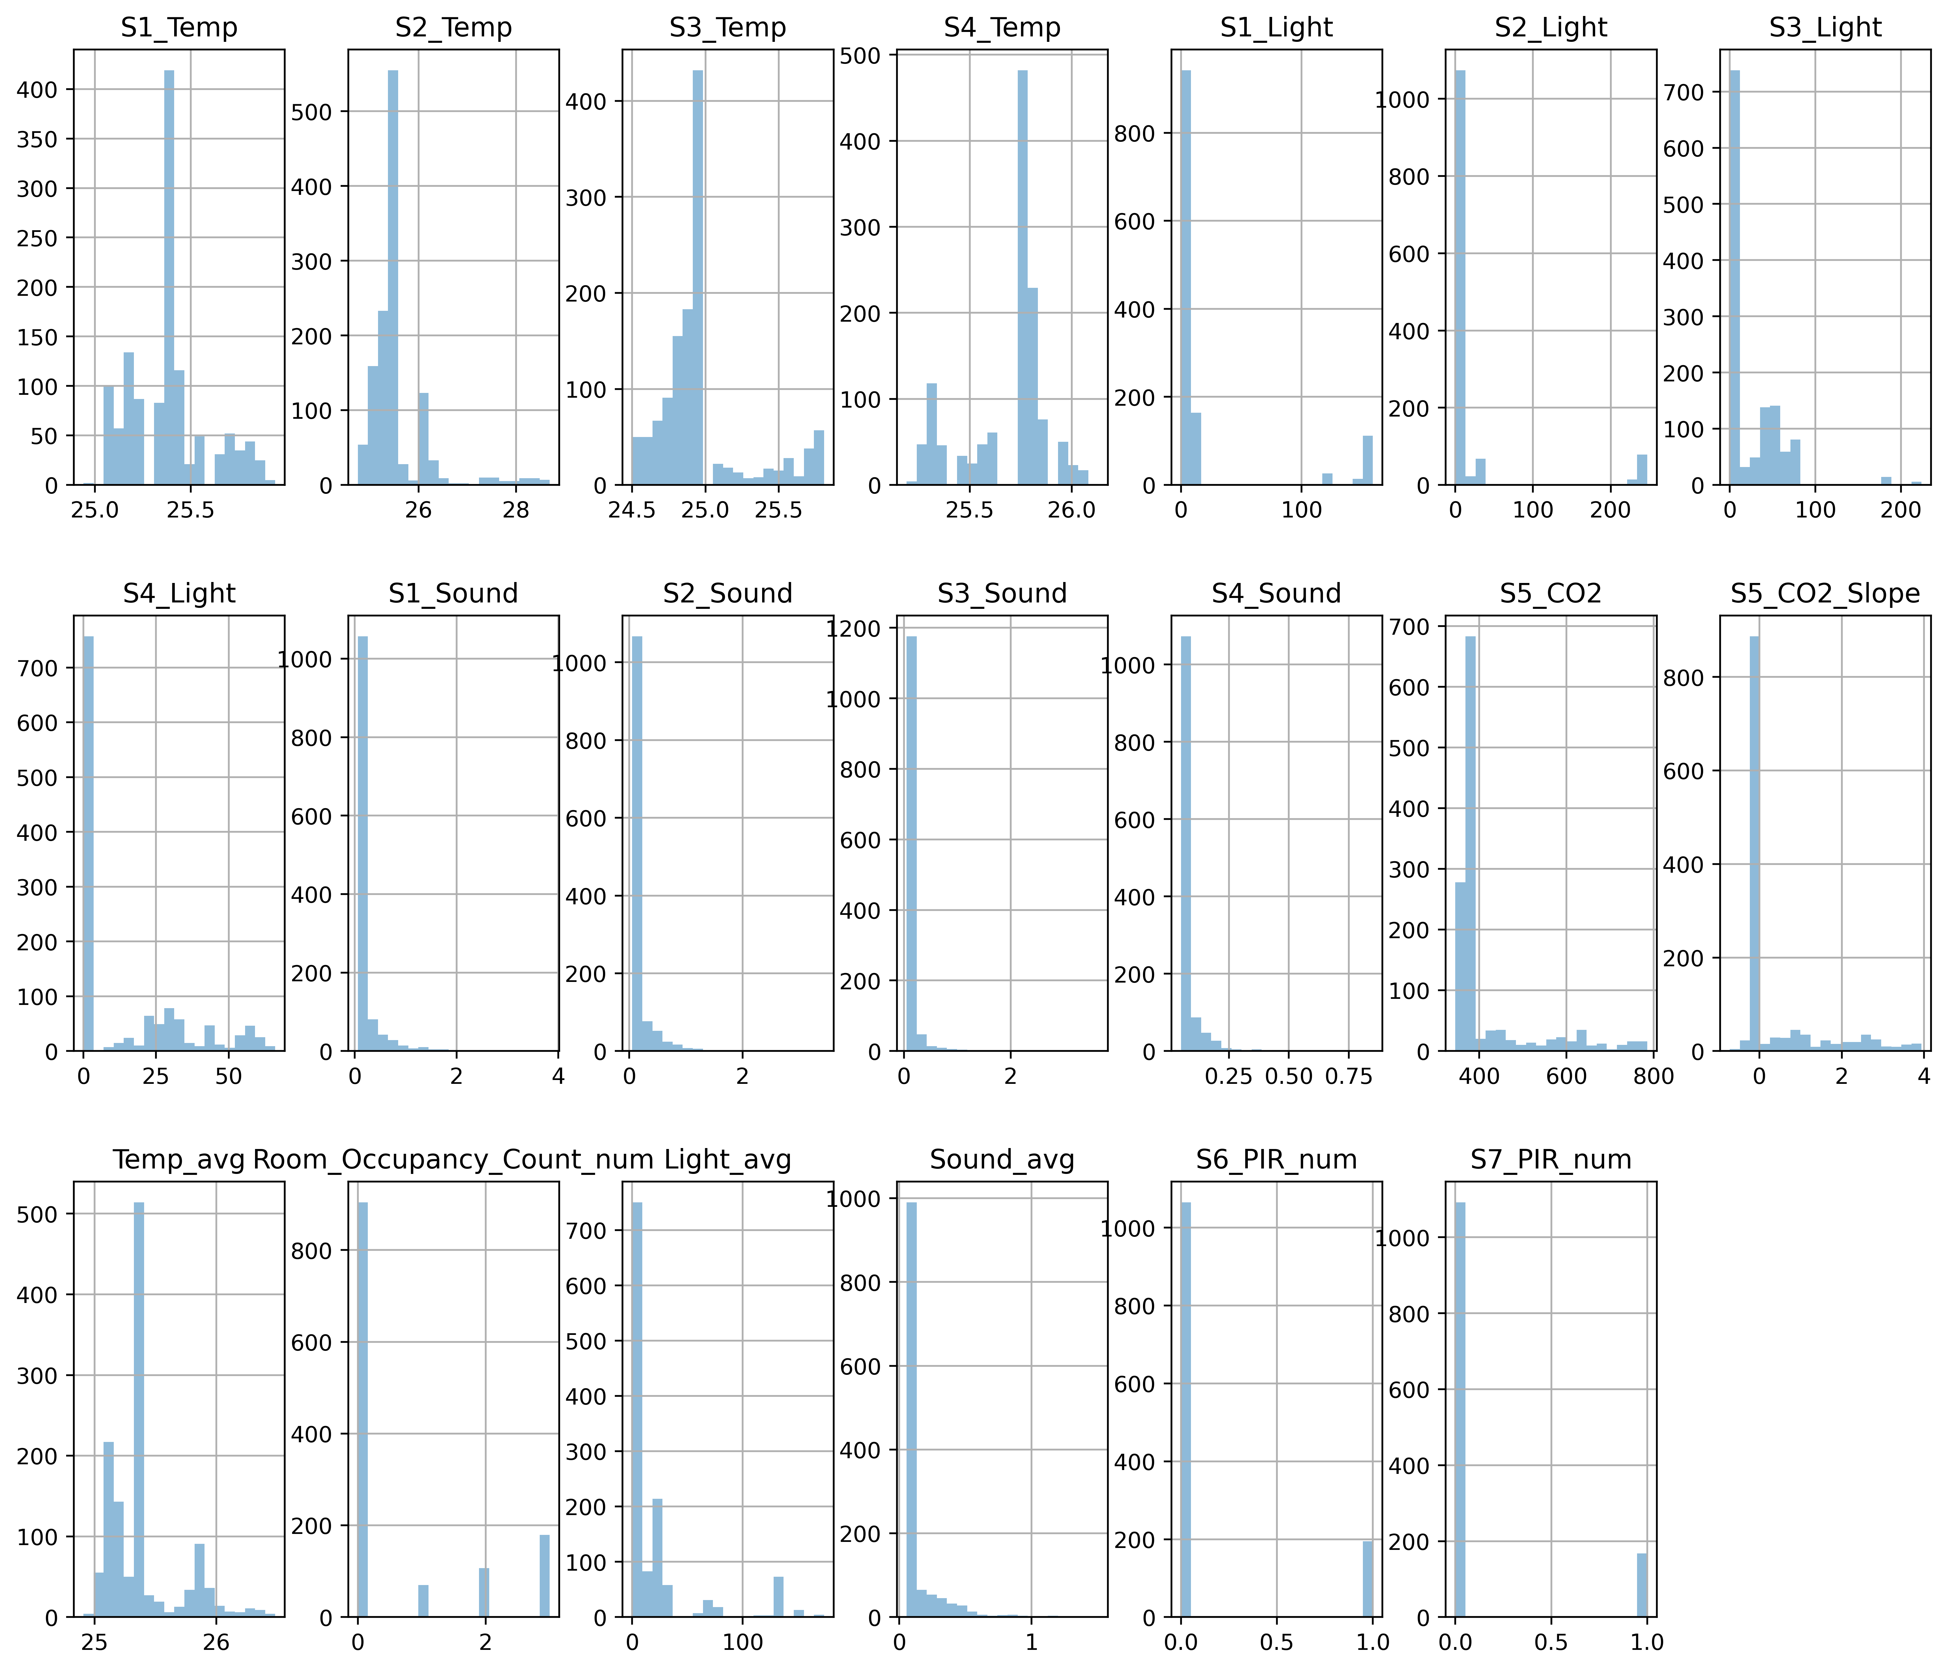
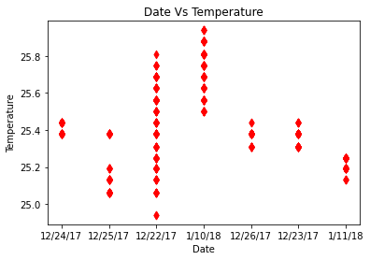
Use of Imputation

Slide 9
Without Use of Imputation

Slide 10
Conclusion
From visualization on Temperature sensor while some days were hotter and some were colder, we can say that temperatures, 25.4-26.4 had more number of room occupants in a given time. We could also say that 25.8 was a comfortable temperature for people to stay as maximum occupants were present in the room at that temperature.
The visualizations with the light signify that there were days with more power usage or possible daylight days because more light caught by sensors on few days than the rest. And we can conclude that there were more people during the late evenings for sleeping or resting.
Visualizations with the sound attribute suggest that there were more people when it was silence or rather no noise. This again leads us towards the conclusion that most of the time, room occupants spent sleeping in the room.
High CO2 levels, High temperatures during certain same days in the dataset makes the story stronger that there were more occupants in the room than the rest.
The visualizations on the montion sensor data signifies that there were occupants in the room when there was maximum motion in the room. Also there were more people in the room at the time of sleeping, which is evident from bar chart PIR vs room occupant count
Major part of the time there were no occupants in the room. Which is significant from both the pie charts. finally we can say that a warm temperature, low light and a considerable CO2 levels suggest there will be occupants present in the room.

Slide 11
Recommendation
Measure of concentration of other harmful gases like carbon monoxide, lead, nitrogen oxides, ground-level ozone, particle pollution (often referred to as particulate matter), and sulfur oxides in the air.
Measurements obtained from Heating, Ventilation and Air Conditioning systems.

